Slide 1
Initial Presentation
Team 2 “Not Yet”

Slide 2
Outline
Project Description
Functional Requirements
Constraints
Quality Attributes
Quality Attribute Scenarios
Plan
Role Assignment

Slide 3


Project Description
Project Name: Sure-Park System
Description:
Geoff’s Transportation and Parking Services has requested to upgrade their traditional parking space to be efficiently working by the introduction of this system. The system shall monitor the parking spaces, provide access, allot parking spaces and do the billing for the users. The status of the system shall be available to attendants and GTPS owners. The system needs to reduce number of people required to operate the garage. Thus increase their profit in the current facility. And shall extend this system to other parking facilities owned by them and be able to sell this solution to other parking facility owners. The software system shall make use of the already installed hardware components at the parking facility.
Stakeholders:
Project Sponsor - GTPS LLC (Geoff’s Transportation and Parking Services)
End user (Driver)
Parking Attendant a.k.a. Dave !!
Other Parking Service Providers
Developer
Project Manager
Operator
Tony, THE CUSTOMER

Slide 4
Functional Requirements (1/2)
# | Description
FR-01 | The system shall provide applications for drivers, attendants and owner.
FR-02 | The system shall reserve a spot using driver's id, date and time, payment information.
FR-03 | The system shall provide whether parking spaces in a garage are available to the driver.
FR-04 | The system shall return the confirmation information to the driver.
FR-05 | The system shall request the confirmation information to the driver when the driver arrives at entry gate.
FR-06 | The system shall verify the driver's confirmation information and confirm the reservation.
FR-07 | The system shall open the entry gate when confirmation information verified.
FR-08 | The system shall show red LED at the gate. And when it detects the presence of a car at the gates, if the car is allowed to pass, green LED shows and lift the gate
FR-09 | The system shall assign a parking space by illuminating the green LED at the assigned parking space.
FR-10 | The system shall notify attendant when a driver parks in the wrong parking space - The system shall reassign the parking space and correlate associated reservation.

Slide 5
Functional Requirements (2/2)
# | Description
FR-11 | The system shall automatically charge on driver's credit card for the duration of stay (half an hour basis).
FR-12 | The system shall take a reservation 3 hours in advance only.
FR-13 | The system shall hold a parking space for a grace-period even if a customer doesn’t show up. And parking space is released if the customer doesn’t show up with in the period.
FR-14 | The system shall show which parking spots are open and which are occupied to attendant.
FR-15 | The system shall show how long a car has occupied a particular spot to attendant.
FR-16 | The system shall have the following statistics for owner. Average occupancy Peak usage hours Parking slot statistics (how much time cars were parked in parking slots) Revenue
FR-17 | The system shall support that the grace-period is configurable.
FR-18 | The system shall support that fee of parking slot is changeable daily. Even if the price is changed, the customers which are already entered to parking facility are charged with old fee.

Slide 6
Constraints
# | Type | Description
CONS-01 | Business | Increase Profits Efficiently utilize the facilities to increase profits
CONS-02 | Business | Low Cost Reduce the # of people required to operate the facilities reducing operation cost
CONS-03 | Technical | Use Dedicated H/W Type Use Arduino 2560, sensors, indicators, and gate actuators
CONS-04 | Business | Schedule We have just 5 weeks to prepare studio project, we have only 6 developers.

Slide 7
Quality Attributes
# | Quality Attribute | Description | Priority
QA-01 | Horizontal Scalability | Increase parking slot size of an existing facility. | High
QA-02 | Vertical Scalability | Add new parking facility. | High
QA-03 | Availability | System should be highly available even if there is a catastrophic failure in a server | High
QA-04 | Extensibility | Add new analysis algorithm or analysis application | Low
QA-05 | Security | System should be protected from unauthorized access. | High
QA-06 | Variability | Market the system to other garage owners | Medium
QA-07 | Configurability | Increase or decrease fee of parking slot. Change the grace-period time | Medium

Slide 8
Quality Attribute Scenario (QA-01)
Raw Quality Attribute | Horizontal Scalability
Scenario | The owner would like to increase parking slot size of an existing facility. When new slots are added, operator is notified, then operator selects an existing facility which owner wants to add new slots to. Also, owner is able to scale up to 500 or more parking slot with undue effort.
Source of Stimulus | Owner
Stimulus | Add more parking slots to an existing facility
Artifact | Parking facility
Environment | Run-time (Normal Operation)
Response | The operator is notified. (Operator selects an existing facility which user wants to add new slots to.) The system increase capacity (the number of available parking slots) of the facility. The system make new communication channel with new micro-controller if it is added.
Response Measurement | The system should increase new parking slot 30 minutes after installation.

Slide 9
Quality Attribute Scenario (QA-02)
Raw Quality Attribute | Vertical Scalability
Scenario | The owner would like to add new parking facility. When new facility is installed, operator can assign name of the facility. Because owner wants to apply this system to N facilities, it should not require undue effort to add new facility.
Source of Stimulus | Owner
Stimulus | Add parking facility.
Artifact | System
Environment | Run-time (Normal Operation)
Response | The operator is notified. (Operator assigns a name of new facility.) The system make new facility and assigns new slots to it. The system make new communication channel with new micro-controller if it is added.
Response Measurement | The system can provide service with new parking facility in 30 minutes after installation.

Slide 10
Quality Attribute Scenario (QA-03)
Raw Quality Attribute | Availability
Scenario | The server is unresponsive as a result of catastrophic failure in a sever during normal operations. The system informs the operator and continues to operate with no downtime.
Source of Stimulus | The server
Stimulus | Catastrophic failure in a server
Artifact | Server software
Environment | Normal operation
Response | System detect failure of a server. Processing is switched from a primary server to a secondary server. Processing is resumed.
Response Measurement | Processing is resumed in less than 30 seconds.

Slide 11
Quality Attribute Scenario (QA-04)
Raw Quality Attribute | Extensibility
Scenario | The developer add new analysis features to the system during runtime. The changes are made without downtime.
Source of Stimulus | Developer
Stimulus | Wishes to add new analysis algorithm or analysis application
Artifact | System
Environment | Run-time
Response | Change made
Response Measurement | Without downtime

Slide 12
Quality Attribute Scenario (QA-05)
Raw Quality Attribute | Security
Scenario | If unauthorized user tries to access data or control sensor/actuator, the system should detects it. If unauthorized user tries several times, the system should block the attacker and inform operator.
Source of Stimulus | Unauthorized user
Stimulus | Attempt to access system several times
Artifact | System
Environment | Run-time (Normal Operation)
Response | The system is protected from unauthorized access. The system blocks unauthorized user. Inform operator.
Response Measurement | The system should notify operator in 5 seconds.

Slide 13
Quality Attribute Scenario (QA-06)
Raw Quality Attribute | Variability
Scenario | Owner would like to market the system to other garage owners around the world. Hence, the reservation and control system interface should be reusable and reconfigurable for new owner.
Source of Stimulus | Other parking service provider
Stimulus | Requests to support variations in reservation system and control system
Artifact | System
Environment | Build time
Response | System with customized reservation and control component
Response Measurement | Customization time should be in 1 month with 5 developers.

Slide 14
Quality Attribute Scenario (QA-07)
Raw Quality Attribute | Configurability
Scenario | Owner would like to increase or decrease fee of parking slot. Also, owner could change the grace-period time to make parking faculties effect if there are many no-show cases. Hence, without system disrupting, system should support to change parking slot fee and grace-period time.
Source of Stimulus | Owner
Stimulus | Change fee of parking slot / Change grace period
Artifact | System
Environment | Run-time (Normal Operation)
Response | Change made
Response Measurement | Without downtime

Slide 15
Plan - Milestones
May 4W
Jun 1W
Jun 2W
Jun 3W
Jun 4W
Sprint 1 *
Sprint 2
Sprint 3
Sprint 4
Detail Design #1
Implementation #1
Integration Test #1
Detail Design #2
Implementation #2
Integration Test #2
System Test
Documents
Final Presentation
Skeleton Code
ADS
Test case
Architectural Design
Protocol Design
* Each Sprint has own iteration process (design, implementation, test, debugging, demo)

Slide 16
Plan - Workload Estimation
Category | Load (%) | Hours
Plan | 10 | 56
Analysis | 20 | 120
Design | 26 | 150
Implementation | 24 | 130
Testing | 20 | 120
Total | 100 | 576
WBS.xlsx

Slide 17
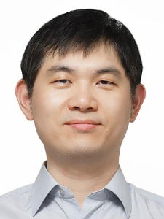
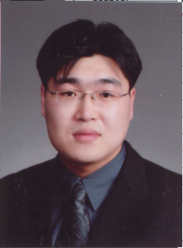
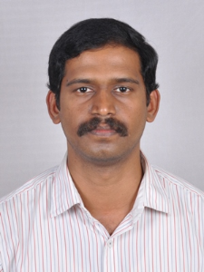
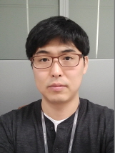
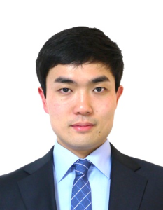

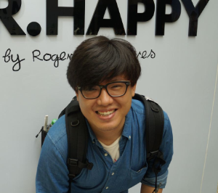
Role Assignment
Sunghoon Yun | Sangjun Lee | Gladvin Chinnadurai | Byounghoon Kim | Wonhong Kwon | Gunwoo Kim | Daniel Plakosh
Team Leader Project Manager | Test Engineer | Requirement Engineer | Stream Designer | Architect Document Writer | Developer | Mentor
 | Jobs | Leader | Participants
Analysis | Requirement / Use-case Architecture Driver Specification | Gladvin Chinnadurai | All members
Design | Architectural Design | Wonhong Kwon
 | Stream Design | Byounghoon Kim
Implementation | Arduino SW Development Server/Application Development | Gunwoo Kim
Testing | Test Case Integration & System Test | Sangjun Lee

